Slide 1
Board Game Recommendation System Team:Fast and Curious
Kamal Tej Veerapaneni
Vinay Maturi
Harish Chandra Jyoshi
Akhila Atluri

Slide 2
Technologies Used
Python
Pandas
sklearn
matplotlib
Javascript
Css,Html

Slide 3
Introduction
Its a simple Machine Learning project using Linear Regression to find the "average_rating"
for a given board game.
In this recommendation engine a dataset of 5000 most popular board game is used. The user then inputs their favorite games and the program creates an "average game" for the user. Euclidean distance is used to compare this average game to the games in the dataset. Finally, the user gets an output of 20 most similar games as recommendations.

Slide 4
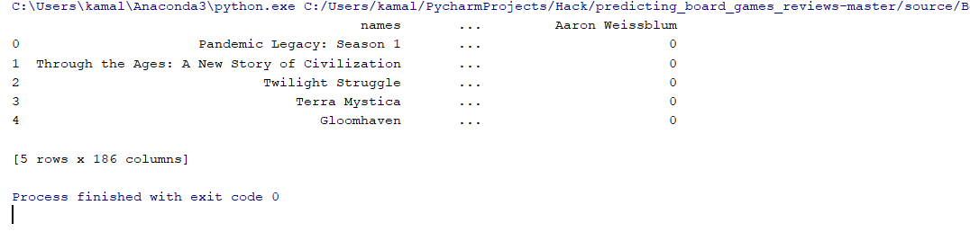
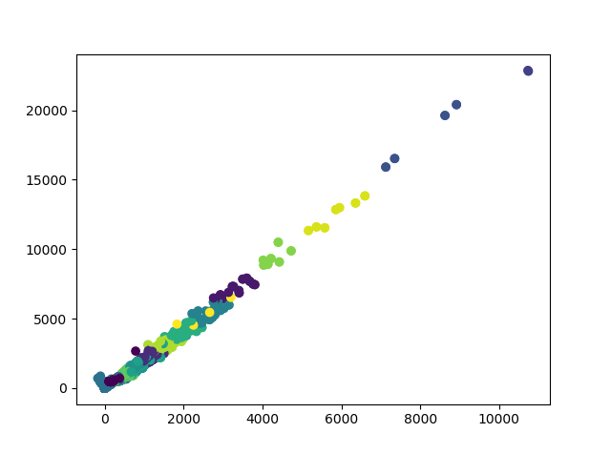
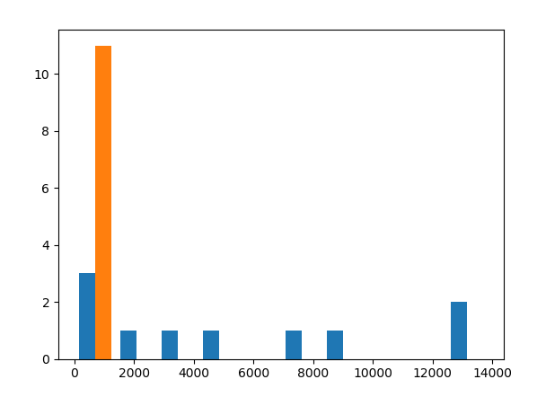
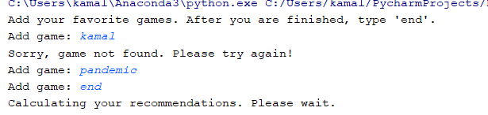
Outputs
Categorical Data
a)Avg_rating
b)Mean vs Standard Deviation
Game Recommendations

Slide 5
Thankyou
Github :https://github.com/Kamaltejveerapaneni/Hackathon-2k18
Youtube:

